Slide 1


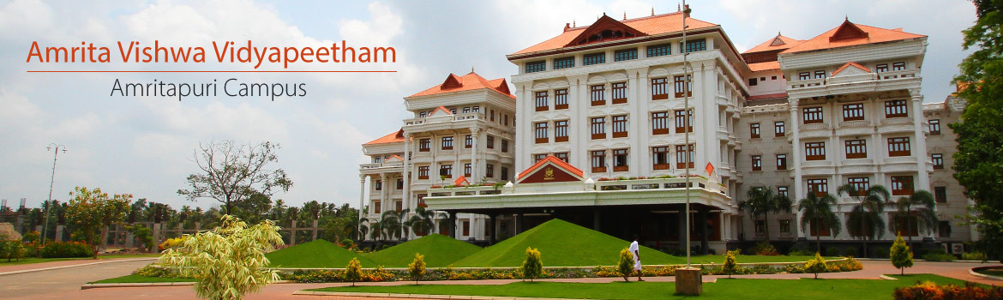
Markov decision Process
-Value Iteration

Slide 2
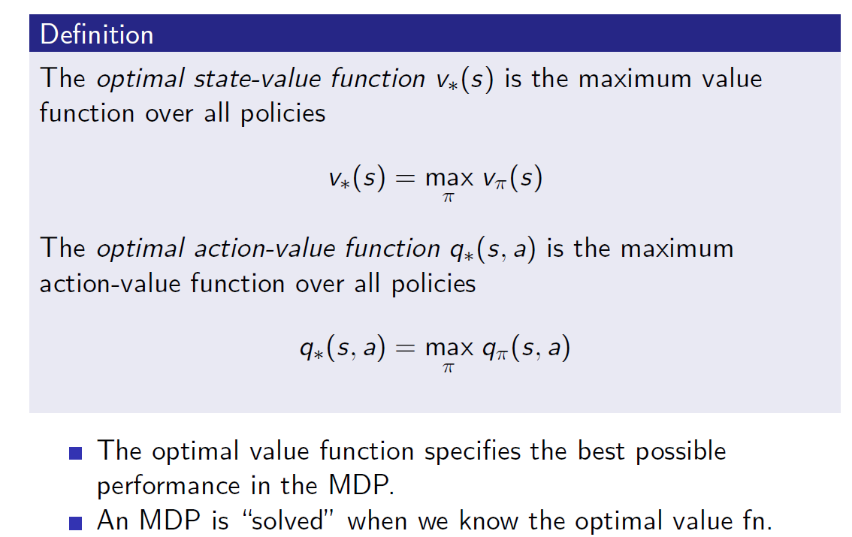
Optimal Value Function

Slide 3
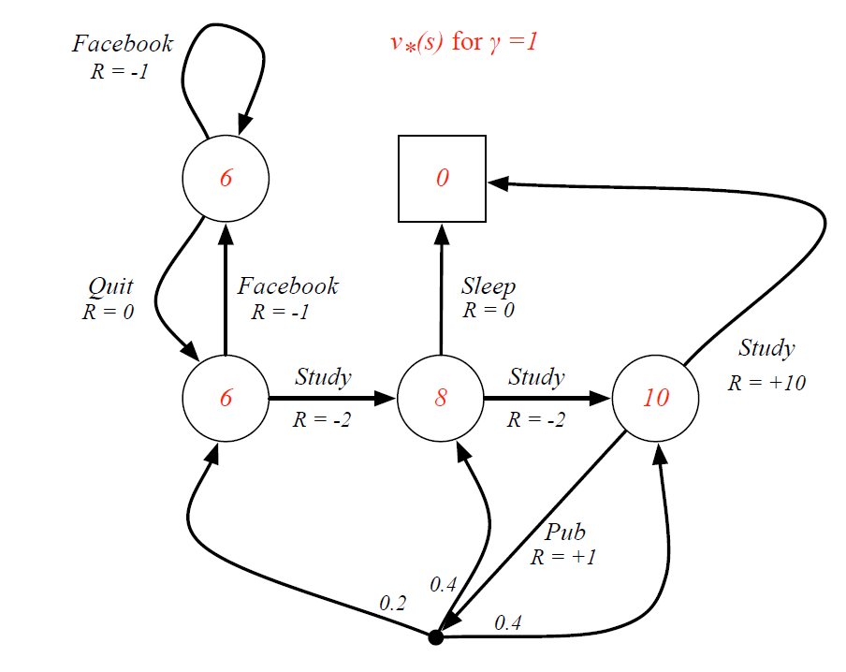
Example: Optimal Value Function for Student MDP

Slide 4
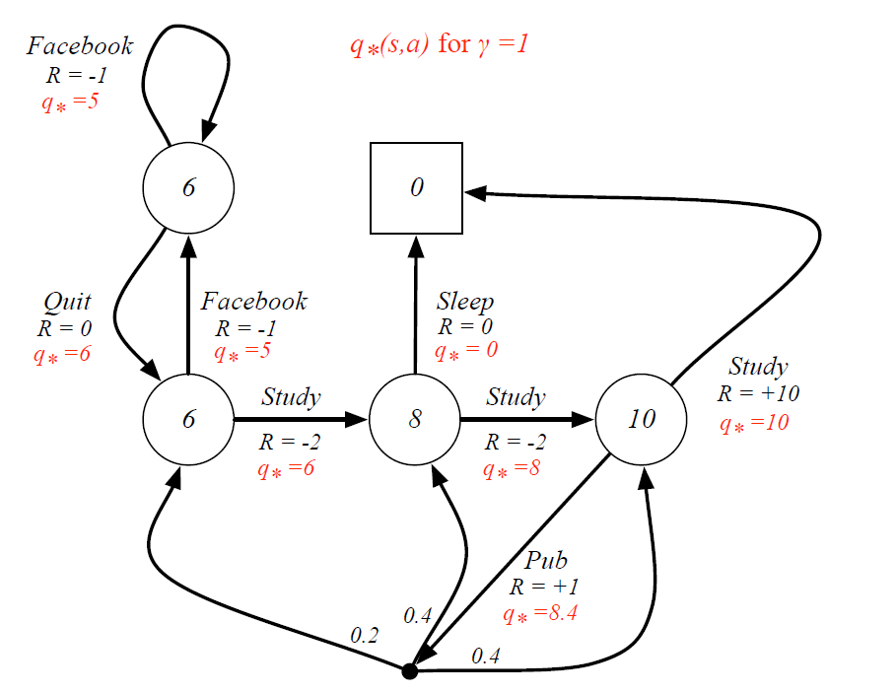
Example: Optimal Action-Value Function for Student MDP

Slide 5
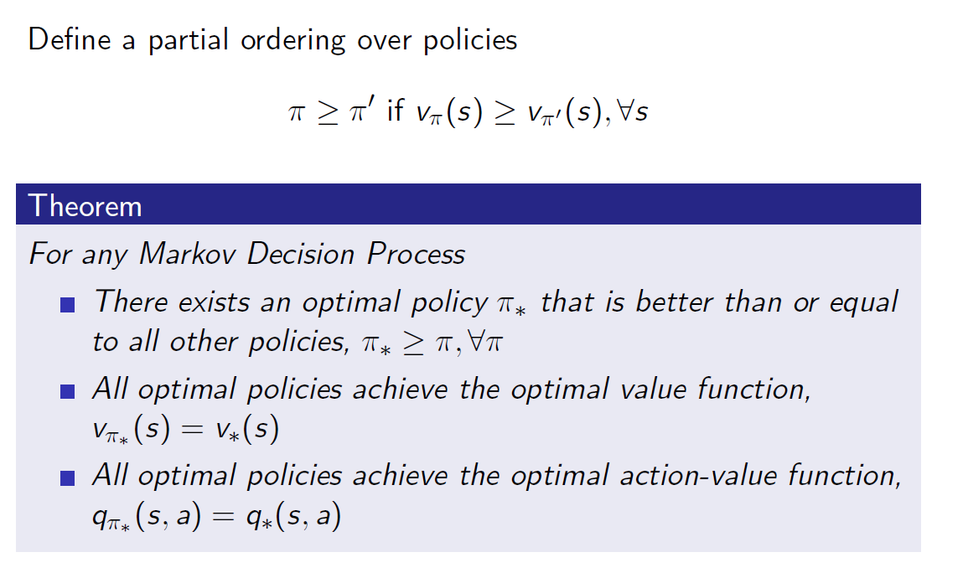
Optimal Policy

Slide 6
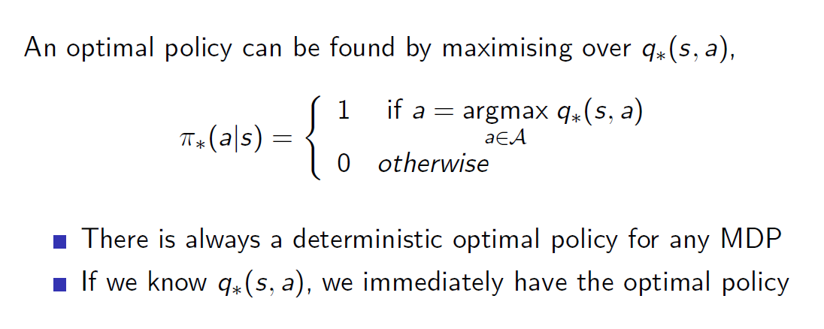
Finding an Optimal Policy

Slide 7
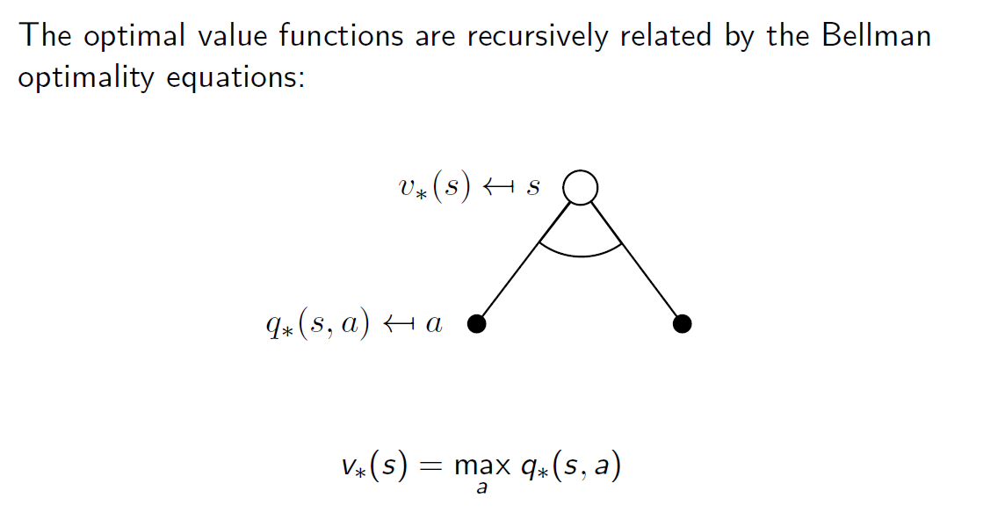
Bellman Optimality Equation for v

Slide 8
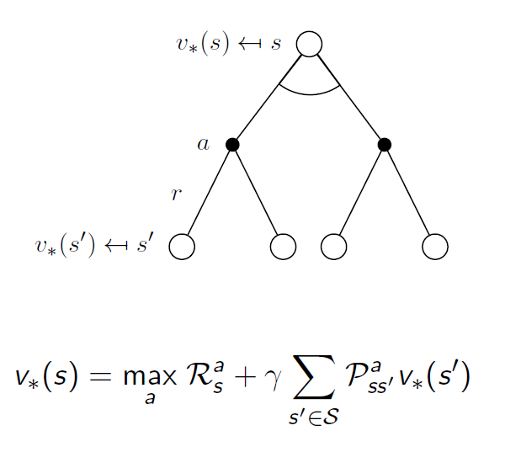
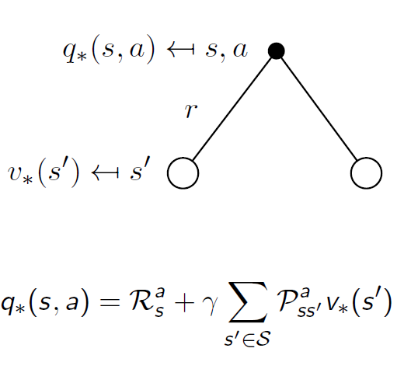
Optimality Equations for V* and Q*

Slide 9
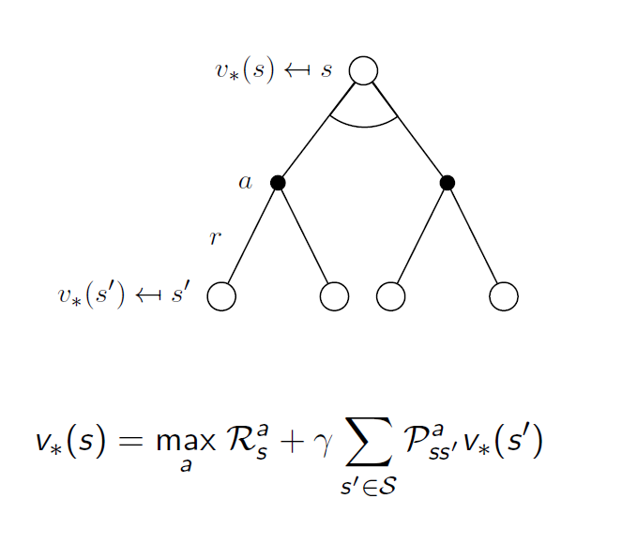
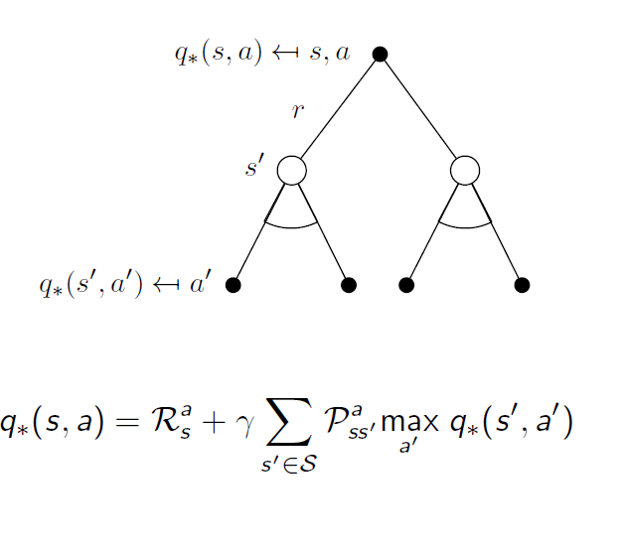
Optimality Equations for V*(2) and Q*(2)
value function for optimal policy can be solved using dynamic programming

Slide 10
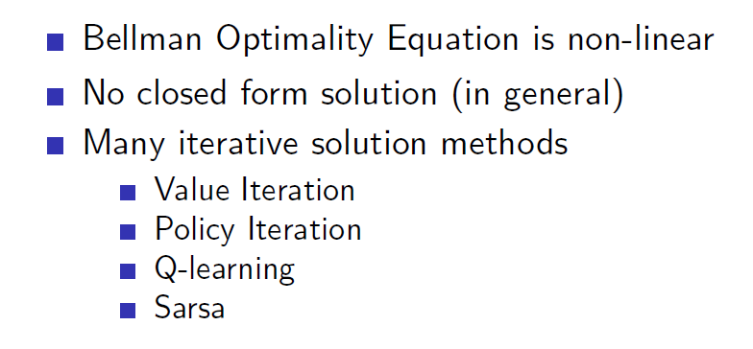

Slide 11

What is Dynamic Programming (DP)?
Algorithm design technique for optimization problems
Divide the problem into a set of smaller subproblems
Solves problems by combining solutions of subproblems.
Overlapping subproblems
Can be applied to problems that requires the recomputation of
to get final solution.
values

Slide 12
Dynamic Programming Approaches
Top dow n approach
  Divide into small sub-problems
  If subproblem already solved, use that solution
  Otherwise, the solution is memoized: to speed up computation by
storing the results and returning the inputs occur again.
  Bottom up approach
▪
cached result when the same
solutions to small problems are calculated
generate the solutionof the problem.
which
combined to

Slide 13
Example Problem
Fibonacci numbers:
▪ F(0) = 0, F(1) = 1
▪ 0, 1, 1, 2, 3, 4, 5, 8, 13, 21, 34, 55, 89, 144, …
▪ F(4) = F(3) + F(2)
▪ F(n) = F(n-2) + F(n-1)

Slide 14
















Recursive Algorithm
Fib(5)
Fib(n)
{
if (n == 0)
return 0;
if (n == 1)
return 1;
Return Fib(n-1)+Fib(n-2)
}
Fib(4)
Fib(3)
Fib(3)
Fib(2)
Fib(1)
Fib(2)
Fib(2)
Fib(1)
Fib(1)
Fib(0)
Fib(1)
Fib(0)
Fib(1)
Fib(0)
F(4) = F(3) + F(2)
= ((F(2) + F(1)) + F(2)
= ((F(1) + F(0)) + F(1)) + (F(1) + F(0))

Slide 15

















Memoization:
Fib(n, mem)
{
if mem[n] != null:
return mem[n] if n <= 1: return n
else:
f = Fib(n-1) + Fib(n-2)
mem[n] = f return f
Fib(5)
Fib(4)
Fib(3)
Fib(3)
Fib(2)
Fib(1)
Fib(2)
Fib(2)
Fib(1)
Fib(1)
Fib(0)
Fib(1)
Fib(0)
Fib(1)
Fib(0)

Slide 16
Dynamic Programming
DP solves problems by combining solutions to subproblems.
DP reduces computation by storing solution to a subproblem the first time it is solved.
Overlapping subproblems
Optimal sub-structure
Key: determine structure of optimal solutions

Slide 17
Optimal substructure
Find shortest path from location X to location Y
▪
Shortest path between X
of smaller subproblems
and Y
such as
composed of optimal solutions
shortest path between two
intermediate locations
Can utilize this property to compute all solutions
DP cannot be applied to problems do not have an optimal substructure
X
P
Q
Y

Slide 18
Steps in Dynamic Programming
Characterize structure of an optimal solution.
Define value of optimal solution recursively.
Compute optimal solution values either top-down or bottom-up
approach
Construct an optimal solution from computed values.
10

Slide 19
Dynamic Programming in RL
Dynamic programming: combine solutions to the sub-problems
  Optimal substructure
  Overlapping sub-problems
Goal of RL is to find a policy that maximize the expected reward
Markov Decision Processes

Slide 20
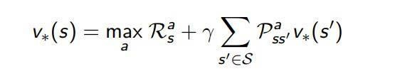
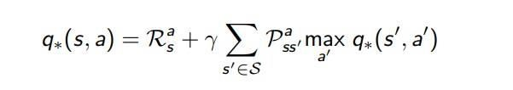
How RL satisfies DP requirements?
Markov decision processes satisfy:
Optimal substructure: recursive decomposition
Overlapping sub-problems: Value function stores and reuses solutions

Slide 21
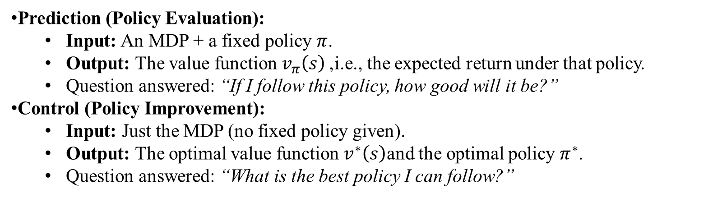
Planning by Dynamic Programming
Dynamic programming requires full knowledge of the MDP
It is used for planning in an MDP
Prediction (Policy Evaluation):
  Input: An MDP + a fixed policy $π$.
  Output: The value function $v_{π}\left(s\right)$, i.e., the expected return under that policy.
  Question answered: “If I follow this policy, how good will it be?”
Control (Policy Improvement):
  Input: Just the MDP (no fixed policy given).
  Output: The optimal value function $v^{∗}\left(s\right)$and the optimal policy $π^{∗}$.
  Question answered: “What is the best policy I can follow?”
10

Slide 22
How to find optimal policy?
if you start optimally, and then always continue optimally, the overall behavior is optimal.
Problem: Find the optimal policy π* for a given MDP.
  Solution: Iterative application of Bellman optimality equation
Principle of Optimality
Any optimal policy can be subdivided into two components which make the overall behaviour optimal
    An optimal first action a∗ followed by an optimal policy from successor
    state S
    A policy π(a|s) achieves the optimal value from state s, v_π(s) = v∗(s), if and
    only if:
      state s’ reachable from s
      πachieves the optimal value from state s’, v_π(s’ )=v∗(s’ )

Slide 23
Value Iteration Algorithm

Slide 24

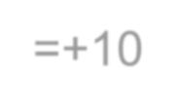




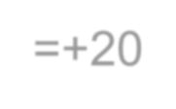

Value Iteration Algorithm
To calculate the values of the states of MDP, probabilities and rewards.
with known
transition
Value Iteration algorithm computes the optimal state iteratively improving the estimate of V(s).
value function by
The algorithm initializes V(s) to arbitrary random values. updates the Q(s, a) and V(s) values until they converge.
It repeatedly
Value Iteration is guarante ed to converge to the optimal values.
r=+10
∞
= 10𝛾^{2𝑖} + 20𝛾^{2𝑖+1}
𝑖 =0
𝑉 1 = 10 + 𝛾 20 + 𝛾 10 + 𝛾 20 + ⋯
1
2
𝑎
+ 𝛾𝑣∗ 𝑠′ )
𝑉∗ 𝑠
= max
𝑎
𝑝_{𝑠𝑠}′ (𝑟 𝑠, 𝑎
𝑠′
r=+20

Slide 25
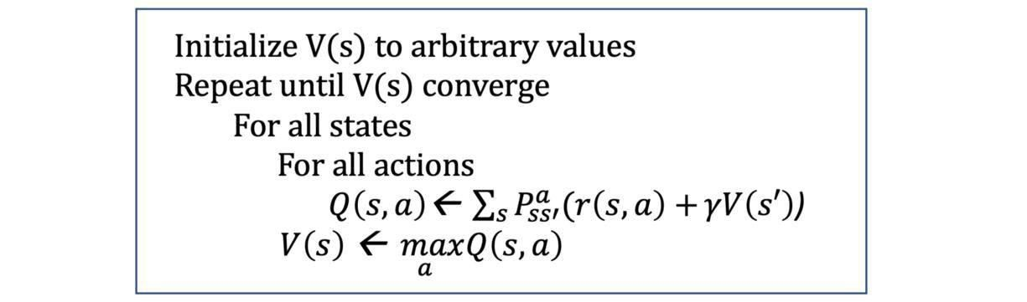
Value Iteration Algorithm

Slide 26
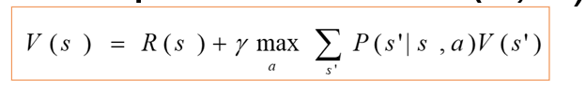

Slide 27
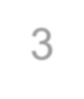




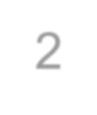








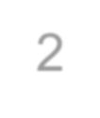
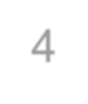
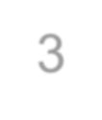
MDPs: Policy
The robot needs to know what to do as the decision process unfolds…
It starts in a state, selects an action, ends up in another state selects
another action….
Needs to make the same decision over and over: Given the current state what should I do?
So a policy for an MDP is a single decision function π(s) that specifies
what the agent should do for each state s
3
+1
2
-1
1
Start
1
2
3
4

Slide 28
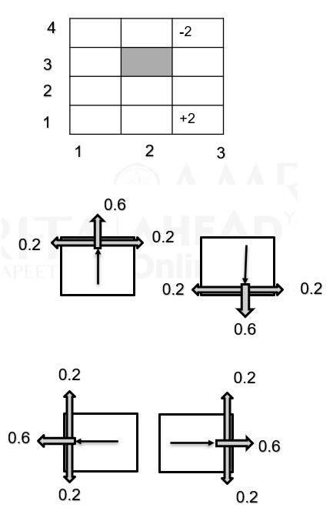
Example MDP
Environment 3 x 4 grid, one blocked state – 11 states
Two terminal states: (3, 4), (3, 1)
Actions: up, down, left, right
0.6 to reach extended effect
0.2 probability to move at right angle of extended
direction
If the agents bumps into a wall, it stays there
Reward:
  For terminal states +/- 2
  Other states: -0.5

Slide 29
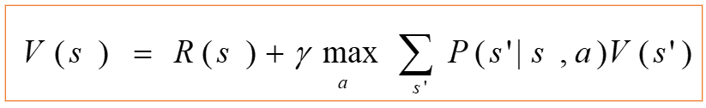
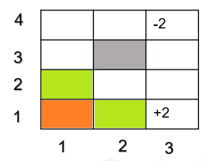
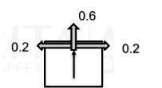

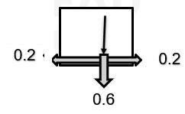
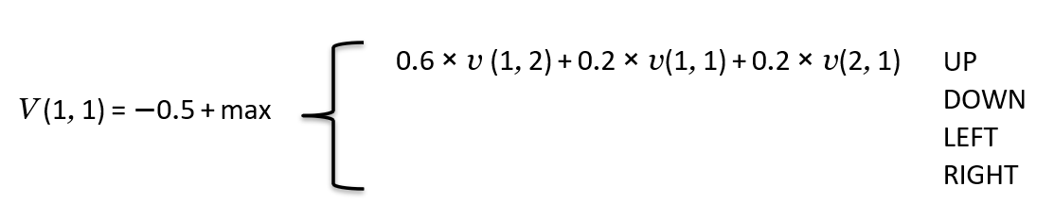

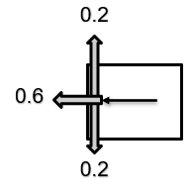

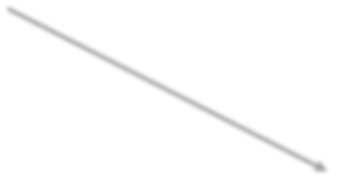
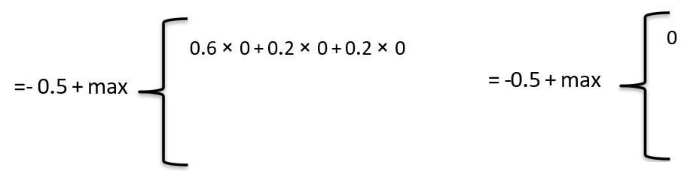
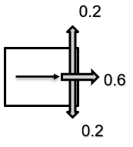
Value Computation: state (1, 1)

Slide 30
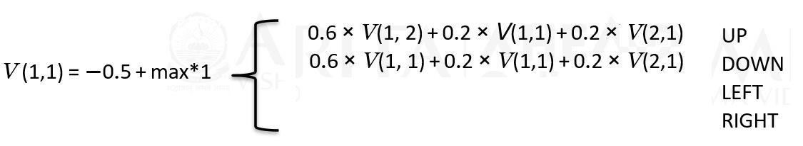
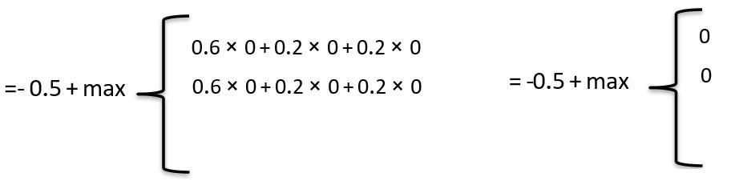
Value Computation: state (1, 1)
V ( s ) =
R ( s ) + γ max ∑ P ( s ' | s , a )V ( s ' )
1
1
a
1
s '

Slide 31
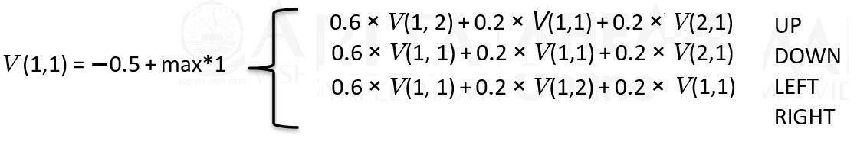
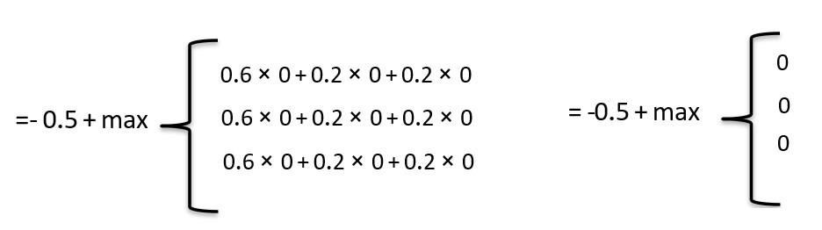
Value Computation: state (1, 1)

Slide 32
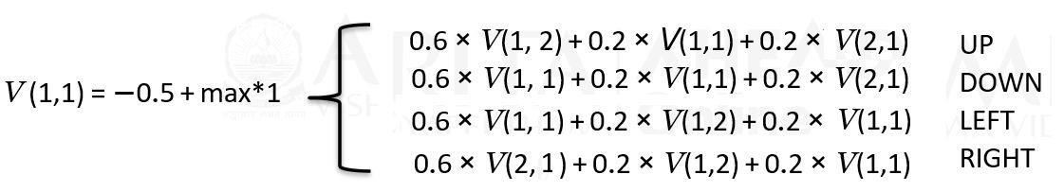
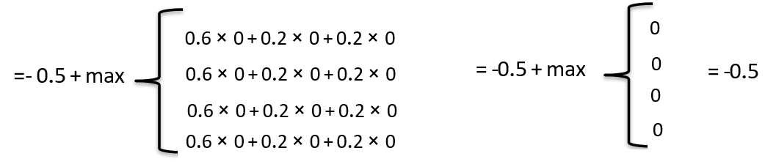
Value Computation: state (1, 1)

Slide 33
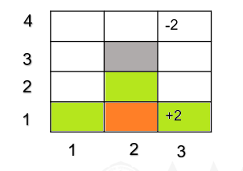
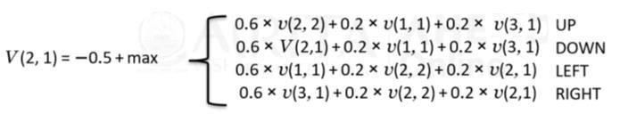
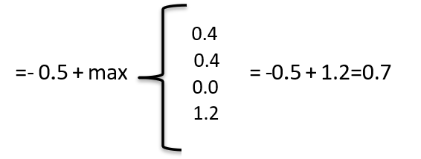
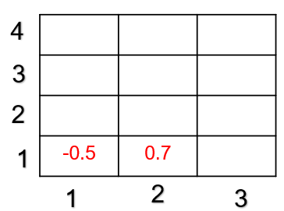
Value Computation: state (2, 1)

Slide 34










V(3, 2)
4
3
2
1
0.7 |  | 0.7
-0.5
1
2
3
5 + ma
V(3, 2) = − 0.5 + max
UP 0.6 × V(3, 3) + 0.2 × V(2, 2) + 0.2 × V(3, 2)
DOWN 0.6 × V(3, 1) + 0.2 × V(2, 2) + 0.2 × V(3, 2)
LEFT 0.2 × V(3, 3) + 0.6 × V(2, 2) + 0.2 × V(3, 1)
RIGHT 0.6 × V(3, 2) + 0.2 × V(3, 3) + 0.2 × V(3, 1)
UP
0.6 × 0 + 0.2 × 0 + 0.2 × 0
0
1.2
0.4
0.4
= -0.5 + max
DOWN 0.6 × 0 + 0.2 × 0 + 0.2 × 0
= 0.7
LEFT RIGHT
0.2 × 0 + 0.6 × 0 + 0.2 × 0
0.6 × 0 + 0.2 × 0 + 0.2 × 0
= -0.5 + max

Slide 35









V(1, 4 ), V(2, 2)
UP 0.6 × V(1, 4) + 0.2 × V(1, 4) + 0.2 × V(2, 4)
DOWN 0.6 × V(1, 3) + 0.2 × V(2, 4) + 0.2 × V(1, 4)
LEFT 0.6 × V(2, 4) + 0.2 × V(1, 4) + 0.2 × V(1, 3)
RIGHT 0.6 × V(1, 4) + 0.2 × V(1, 4) + 0.2 × V(1, 3)
V(1, 4) = − 0.5 +1* max
4
3
2
1
-0.5
= -0.5
0.7
-0.5
0.7
5 + ma
V(2, 2) = − 0.5 +1* max
UP 0.6 × V(2, 2) + 0.2 × V(3, 2) + 0.2 × V(1, 2)
DOWN 0.6 × V(2, 1) + 0.2 × V(1, 2) + 0.2 × V(3, 2)
LEFT 0.6 × V(1, 2) + 0.2 × V(2, 2) + 0.2 × V(2, 1)
RIGHT 0.6 × V(3, 2) + 0.2 × V(2, 2) + 0.2 × V(2, 1)
-0.5
1
2
3
0
= -0.5 + 1*max
0
0
0
= -0.5

Slide 36








V(2, 4), V(2, 2)
UP 0.6 × V(2, 4) + 0.2 × V(1,4) + 0.2 × V(3, 4)
DOWN 0.6 × V(2, 4) + 0.2 × V(1, 4) + 0.2 × V(3, 2)
LEFT 0.6 × V(3, 4) + 0.2 × V(2, 4) + 0.2 × V(3, 3)
RIGHT 0.6 × V(1, 4) + 0.2 × V(2, 2) + 0.2 × V(2, 4)
V(2, 4) = − 0.5 +1* max
4
3
2
1
-0.5
-0.8
= -0.8
0.7
-0.5
.5 +
UP 0.6 × V(3, 4) + 0.2 × V(3, 3) + 0.2 × V(3, 3)
-0.5
DOWN 0.6 × V(3, 2) + 0.2 × V(3, 3) + 0.2 × V(3, 2)
V(2, 2) = − 0.5 +1* max
LEFT 0.6 × V(2, 3) + 0.2 × V(3, 4) + 0.2 × V( 3, 2)
RIGHT 0.6 × V(3, 3) + 0.2 × V(2, 4) + 0.2 × V(3, 2)
1
2
3
0
= -0.5 + 1*max
0
0
0
= -0.5
10

Slide 37
After First iteration
-0.5 | -0.8 | -2
-0.5 |  | -0.8
-0.5 | -0.5 | 0.7
-0.5 | 0.7 | +2

Slide 38

Second iteration V(1, 1)
-0.5 | -0.8 | -2
-0.5 |  | -0.8
-0.5 | -0.5 | 0.7
-0.5 | 0.7 | +2
+ max
UP 0.6 × V(1, 2) + 0.2 × V(1,1) + 0.2 ×V(2,1)
DOWN 0.6 × V(1, 1) + 0.2 × V(1,1) + 0.2 × V(2,1)
LEFT 0.6 × V(1, 1) + 0.2 × V(1,2) + 0.2 × V( 2,1)
RIGHT 0.6 × V(2, 2) + 0.2 × V(1,2) + 0.2 × V(1,1)
V(1,1) = − 0.5 + max*1
-0.26
-0.66
-0.50
0.22
= -0.5 + max
= -0.28

Slide 39
Second iteration
UP 0.6 × V(2, 2) + 0.2 × V(1, 1) + 0.2 × V(2, 4)
DOWN 0.6 × V (2,1) + 0.2 × V(1, 1) + 0.2 × V(3, 2)
LEFT 0.6 × V(1, 1) + 0.2 × V(2, 2) + 0.2 × V(2, 1)
RIGHT 0.6 × V(3, 1) + 0.2 × V(2, 2) + 0.2 × V(2, 1)
V (2,1) = −0.5 + max*1
= -0.8
0
0.72
-0.26
= −0.5 + max*1
= -0.5+0.72=0.22
-0.08
max
UP 0.6 × V(1, 3) + 0.2 × V(1, 2) + 0.2 × V(1, 2)
DOWN 0.6 × V (1, 2) + 0.2 × V(1, 2) + 0.2 × V(2, 2)
LEFT
RIGHT
V (1,2) = −0.5 + 1*max

Slide 40

Second iteration
UP 0.6 × V(2, 2) + 0.2 × V(1, 2) + 0.2 × V(3, 2)
DOWN 0.6 × V(2, 1) + 0.2 × V(1, 2) + 0.2 × V(2, 2)
LEFT 0.6 × V(1, 2) + 0.2 × V(2, 2) + 0.2 × V(2, 2)
RIGHT 0.6 × V(3, 2) + 0.2 × V(2, 2) + 0.2 × V(2, 2)
V(2, 2) = − 0.5 + max*1
= -0.8
-0.3-0.10+0.14
-0.42-0.10+0.10
= − 0.5 + max
-0.30-0.10-0.14
0.42-0.10-0.14
max
UP -0.26
DOWN 0.22
LEFT -0.26
RIGHT 0.46
= − 0.5 + max
= − 0.5 +0.16=-0.04

Slide 41

Second iteration
UP 0.6 × V(3, 3) + 0.2 × V(3, 2) + 0.2 × V(3, 2)
DOWN 0.6 × V(3,1) + 0.2 × V(2,2) + 0.2 × V(3, 2)
LEFT 0.6 × V(2, 2) + 0.2 × V(3, 3) + 0.2 × V(3, 1)
RIGHT 0.6 × V(3, 2) + 0.2 ×V(5, 3) + 0.2 × V(3, 1)
V(3, 2) = − 0.5 + max*1
-0.48-0.10+0.14
-0.12-0.10+0.14
-0.30-0.10-0.40
0.42-0.10-0.40
= − 0.5 + max
= − 0.5 +0.66=-0.16

Slide 42


Second iteration
UP 0.6 × V(3, 4) + 0.2 × V(3, 3) + 0.2 × V(3, 3)
DOWN 0.6 × V(3, 2) + 0.2 × V(3, 3) + 0.2 × V(3, 3)
LEFT 0.6 × V(3, 3) + 0.2 × V(3, 4) + 0.2 × V(3, 2)
RIGHT 0.6 × V(3, 3) + 0.2 × V(3, 4) + 0.2 × V(3, 2)
V(3, 3) = − 0.5 + max
0.6x-2+0.2x-0.8+0.2x-0.8
0.6x0.7+0.2x-0.8+0.2x-0.8
0.6x-0.8+0.2x-2+0.2x0.7
0.6x-0.8+0.2x-2+0.2x0.7
-1.52
0.1
0.22
0.22
= − 0.5 + max
= − 0.5 + max
= − 0.5 +0.22=--0.21

Slide 43


Second iteration
UP 0.6 × V(2, 4) + 0.2 × V(1, 4) + 0.2 × V(3, 4)
DOWN 0.6 × V(2, 4) + 0.2 × V(1, 4) + 0.2 × V(3, 4)
LEFT 0.6 × V(1, 4) + 0.2 × V(2, 4) + 0.2 × V(3, 4)
RIGHT 0.6 × V(3, 4) + 0.2 × V(2, 4) + 0.2 × V(2, 4)
V(2, 4) = − 0.5 + max*1
-0.98
-0.98
-0.6
-0.49
= − 0.5 + max
= − 0.44

Slide 44


Second iteration
UP 0.6 × V(1, 4) + 0.2 × V(1, 3) + 0.2 × V(1, 3)
DOWN 0.6 × V(1, 2) + 0.2 × V(1, 3) + 0.2 × V(1, 3)
LEFT 0.6 × V(1, 3) + 0.2 × V(1, 4) + 0.2 × V(1, 2)
RIGHT 0.6 × V(1, 3) + 0.2 × V(1, 4) + 0.2 × V(1, 2)
V(1,3) = − 0.5 + max*1
-1.0 | -0.44 | -2
-1.0 |  | -0.28
-1.00 | -0.04 | 0.16
-0.35 | 0.22 | +2
max
= − 0.5 + max*1
UP -0.30-0.10-0.10
DOWN -0.30-0.10-0.10
LEFT -0.30-0.10-0.10
RIGHT -0.30-0.10-0.10
-0.98
-0.98
-0.6
-0.49
= − 0.5 + max
=-0.5-0.5=-1.0

Slide 45
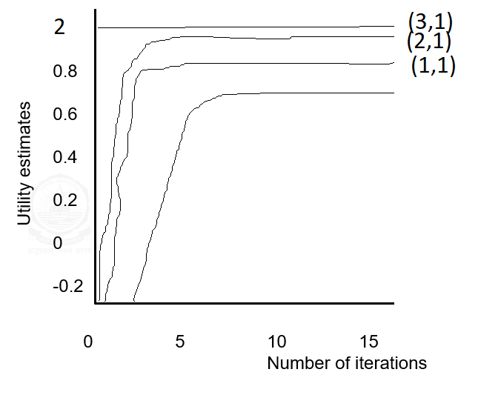
State values as function of iteration number

Slide 46
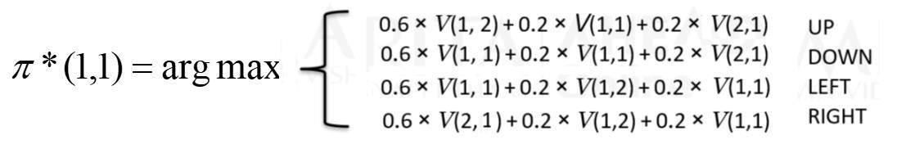
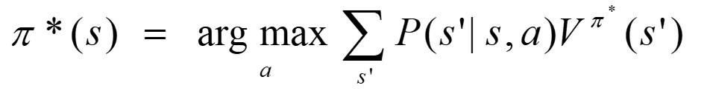
Finding policy from value function
The action of the optimal policy is the one
that maximizes the expected value function
For state (1,1)
0.7 | 0.4 | -2
0.6 |  | 0.5
0.6 | 0.7 | 0.86
0.8 | 0.85 | +2
In general:
CPSC 422, Lecture 5
Slide 4

Slide 47
Value Iteration Process
 |  | -2
 |  | +2
0.7 | 0.4 | -2
0.6 |  | 0.5
0.6 | 0.7 | 0.86
0.8 | 0.85 | +2
1.Given environment
2.Calculate State Values
 | ← | -2
→ | →
→ | → | +2
-2
+2
3.Extract optimal policy
4.Execute actions

Slide 48
Value Iteration Algorithm
Initialize V arbitrarily V(s)=0 for all s∈𝑆⁺
Repeat
∆←0
For each s∈S:
  𝑣 ← 𝑉 𝑠
  𝑎
V(s)← 𝑚𝑎𝑥𝑎 𝑃 [𝑅
+ 𝛾𝑉(𝑠′ )]
𝑎
𝑠′ 𝑠𝑠
𝑠𝑠
′
∆←max(∆,|v-V′ (s)|)
Until ∆<θ (a small positive number)
Output: π,such that
π(s)=argmax_{a}
𝑎
𝑎
′ + 𝛾𝑉 𝑠′ ]
𝑃 [𝑅
𝑠′ 𝑠 𝑠
′
𝑠𝑠

Slide 49
Namah Shivaya

